Slide 1
VOICE
Active vs. Passive
Weak vs. power

Slide 2
VOICE
The writer’s voice is the individual writing style of an author, a combination of idiotypical usage of syntax, diction, punctuation, character development, dialogue, etc., within a given body of text (or across several works).

Slide 3
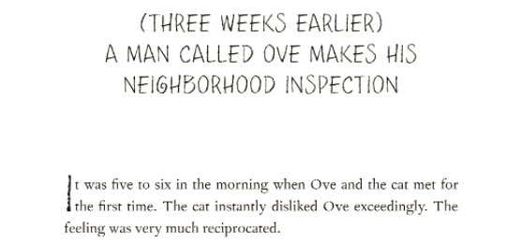
Example: Frederik backman

Slide 4
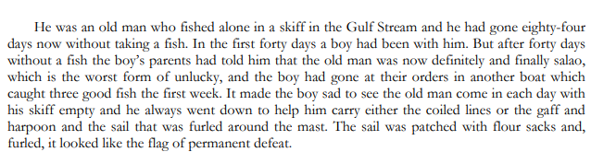
Example: ernest Hemingway

Slide 5
Active voice:
When the subject of the sentence Does something
The man hid the dirty laundry.
The dog ate the food.

Slide 6
Passive VOICE:
When the subject is Acted upon by the verb.
The dirty laundry was hidden by the man.
The food was eaten by the dog.

Slide 7
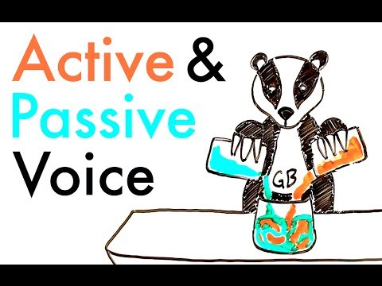
A video! Because it’s cute!

Slide 8
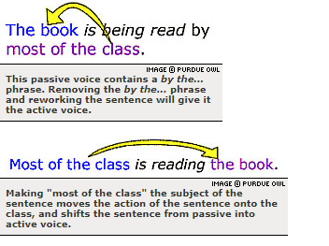
Changing passive to active

