Slide 1
MLA FORMAT
Frequent Questions & Mistakes

Slide 2
Problem 1: paraphrasing ALWAYS cite when you paraphrase—the information is someone else’s work.
ORIGINAL TEXT:
Students frequently overuse direct quotation in taking notes, and as a result they overuse quotations in the final [research] paper. Probably only about 10% of your final manuscript should appear as directly quoted matter. Therefore, you should strive to limit the amount of exact transcribing of source materials while taking notes. Lester, James D. Writing Research Papers. 2nd ed., 1976, pp. 46-47.
ACCEPTABLE PARAPHRASE:
In research papers, students often quote excessively, failing to keep quoted material down to a desirable level. Since the problem usually originates during note taking, it is essential to minimize the material recorded verbatim (Lester 46-47).

Slide 3
Problem 2: Formatting quotes
General Format:
Your sentence “your quote” (citation).
Quote inside a quote:
Your sentence “quotation ‘more quotation’” (citation).

Slide 4
Problem 3: Author Citations
Sources with an author:
“Your quote” (Smith 12).
Sources without an author:
“Your quote” (“Polar Bears”).
Sources with three or more authors:
“Your quote” (Smith et al. 12).
Indirect Sources:
“Your quote” (Johnson qtd. in Smith 12).

Slide 5
Problem 4: Name should be the SAME
In text citation:
Education should be a right for all people, because “the elite have failed to create a true meritocracy for all” (Smith 12).
Works Cited citation:
Smith, John. Education and Meritocracy in the U.S. New York, Hyperion, 1999.
Recent changes:
Commas are used instead of periods between Publisher, Publication Date, and Pagination.
Medium is no longer necessary. (e.g. Print, ebook, audiobook).

Slide 6
Problem 5: Works Cited Guidelines
“Works Cited” should be top and centered.
1” margins all around.
All sources alphabetical by first word.
Double spaced throughout.
Hanging Indent on each source (.5”).
All citations end in a period.
No hyperlinks.
Citations are left oriented.

Slide 7
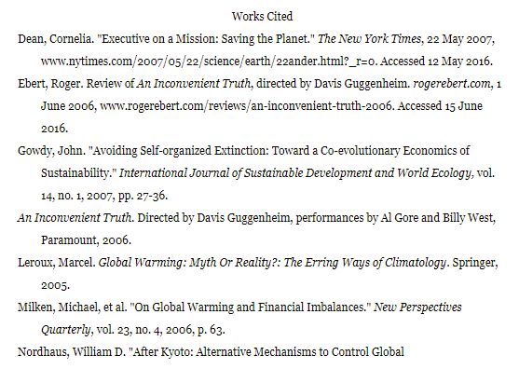

Slide 8
Problem 6: Conclusions!
Non-negotiables:
Restate your thesis in a different way.
Recapitulate your main arguments.
Flexible:
Make modern-day connections.
Tell your reader why this argument matters.

Slide 9
Without a doubt, the society and politics of the United States were impacted by the rise of gay empowerment and the liberation movements that were influenced by none other than the Stonewall Riots and its legacy. For the first time in history, the homosexual community, with the aid of the mindset that Stonewall created, was finally able to redefine themselves into a new identity that was presented in American society as bold and fearless. With these new militant identities, gay liberation organizations that adopted Stonewall as their most significant inspiration began to flourish, ultimately becoming influential themselves as they left remarkable impacts on the gay community and the progression of equality. Furthermore, the politics of America were ultimately affected as gay activists were finally motivated to advocate and fight for homosexual equality through the spirit of reformation that the Stonewall Riots had left on the gay community. With the major influences that its legacy had left in the United States, it is evident that the Stonewall Riots is truly the symbolic LGBT movement that was able to pave the pathway to justice for the gay community. Today, thanks to the riots and the revolutionary movement it sparked, the LGBT community is now more widely accepted in the United States than it has ever been before, and same-sex marriage is now legalized under the Equality Act of 2015. Though the LGBT community still has a long way to go to end homophobia and discrimination, it is without a doubt that the Stonewall Riots will never cease to influence the community and lead them into the direction of equality.

